Slide 1
Review paper – DRCN 2024
Divya Khanure (DXK210081)

Slide 2
Index
On Board-level Failure Localization in Optical Transport Networks Using Graph Neural Network
Energy Consumption Analysis of NIST Selected Post-Quantum Digital Signature Algorithms for Quantum Secure Communications

Slide 3
On Board-level Failure Localization in Optical Transport Networks Using Graph Neural Network
Functional graphs (FGs) are garnered by iteratively tagging each board in the network topology.
Board-Alarm Propagation Tree-based Failure Localization (BAPT-FL) is used on the network topology built.
A range of BAPTs is built based on the correlation of the tagged boards and alarms involved in the FGs, where each BAPT deems a failed board and its correlated alarms as the root and leaves, respectively.
Uses Graph Neural Network on the edge network as an edge classifier, which characterizes each vertex/edge from diverse dimensions including time, traffic distribution, network topology, and board/alarm attribute.
Finally, the Integer Linear Programming (ILP) problem is used to construct the best possible BAPT.

Slide 4
On Board-level Failure Localization in Optical Transport Networks Using Graph Neural Network
Optical Transport Networks (OTN) layers encompass the optical transport section (OTS), optical multiplex section (OMS), and optical channel (OCH).
Each OCH (i.e. lightpath) traverses various types of device boards connected in series, such as the fiber segment, optical amplifier (OA), fiber interface unit (FIU), optical multiplexer (OM), optical demultiplexer (OD), optical transponder unit (OTU), etc.
OTN control plane harnesses a comprehensive set of rigid alarming mechanisms at each board for monitoring system performance. OTN board will report an alarm to the network management system (NMS).
A failure event inevitably leads to an alarm flood, considerably boosting the complexity of alarm analysis and failure localization, particularly in the network domains with many boards such as the OTN.

Slide 5
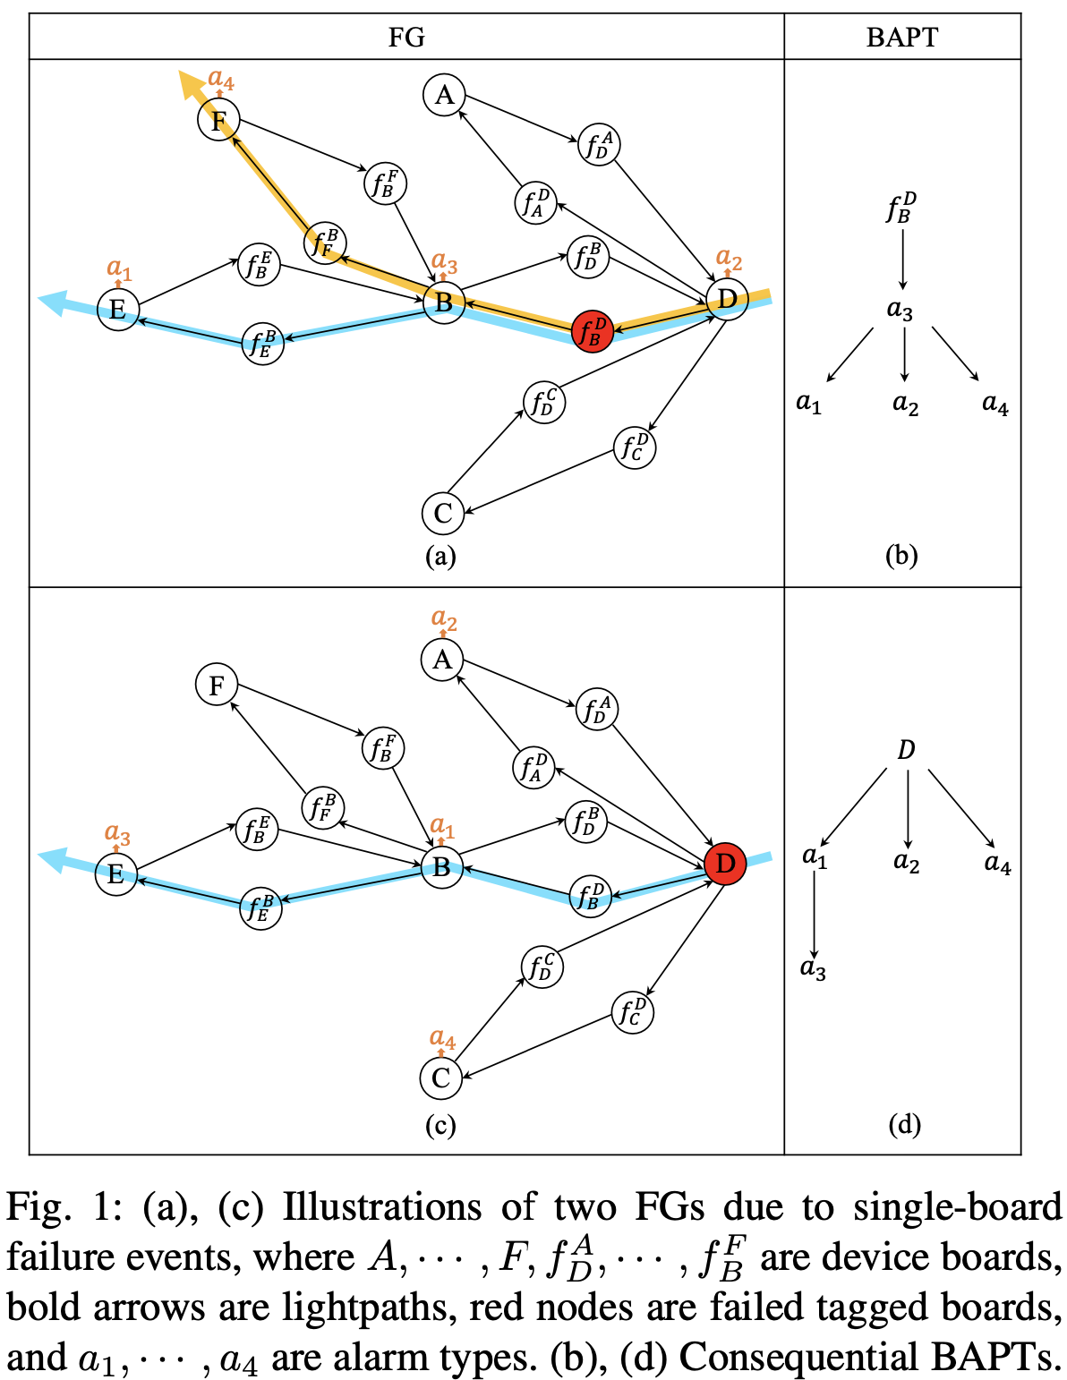
On Board-level Failure Localization in Optical Transport Networks Using Graph Neural Network
Alarm correlation – an approach to discerning the dependencies among alarms.
The failure-alarm propagation phenomenon resulting from a failed tagged board in an FG is portrayed by a Board-Alarm Propagation Tree (BAPT)

Slide 6
On Board-level Failure Localization in Optical Transport Networks Using Graph Neural Network
Board-Alarm Propagation Tree based Failure Localization (BAPT-FL) –
During an observation window (OW) of a given network state, the status of each board can change no more than once at the beginning of this OW, i.e., either maintaining normal or transitioning from normal to failed, incurring an alarm set.
define an FG as a tagged board-centric graph that contains all boards functionally related to the tagged one.
Based on an FG, a BAPT represents the tree-shape correlation between the failed tagged board and alarms, where each board/alarm is featured by several attributes including its occurrence time and board type, and alarm type.

Slide 7
On Board-level Failure Localization in Optical Transport Networks Using Graph Neural Network
Contributions –
Propose a novel board-level failure localization framework, referred to as BAPT-FL, which leans on a graph edge binary classifier and BAPT modeling approach.
Leverage GNN for building a novel graph edge binary classifier. This classifier offers superior adaptability and generality to versatile network environments by considering both boards and alarms.
Formulate the BAPT formation problem as an ILP to obtain the optimal BAPT(s), fulfilling both failure localization and alarm correlation.
Conduct extensive case studies on single-board and regional failure events to verify the raised BAPT-FL. The results demonstrate its capability of precisely localizing failed device boards in the OTN optical layers.

Slide 8
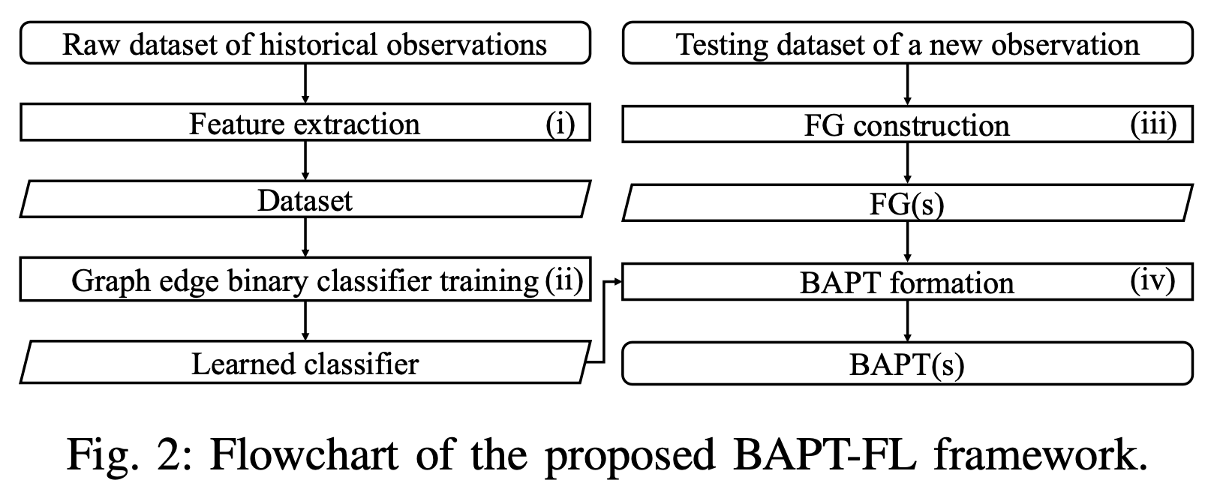
On Board-level Failure Localization in Optical Transport Networks Using Graph Neural Network
Proposed BAPT-FL Framework –

Slide 9
On Board-level Failure Localization in Optical Transport Networks Using Graph Neural Network
Proposed BAPT-FL Framework –
Feature Extraction –
The raw dataset is composed of historical observations collected from a set of OWs.
The network topology, traffic distribution, alarm set, failure event, and BAPTs are observed.
A feature space with dimensions including time, network topology, traffic distribution, and board/alarm attributes, given below:
For each vertex within a BAPT, board type, alarm type, and layer information are considered.
For each edge within a BAPT, occurrence time gap, physical distance, hop distance, lightpath label are extracted.
This mapped BAPT to the feature will be used for training the graph edge binary classifier.

Slide 10
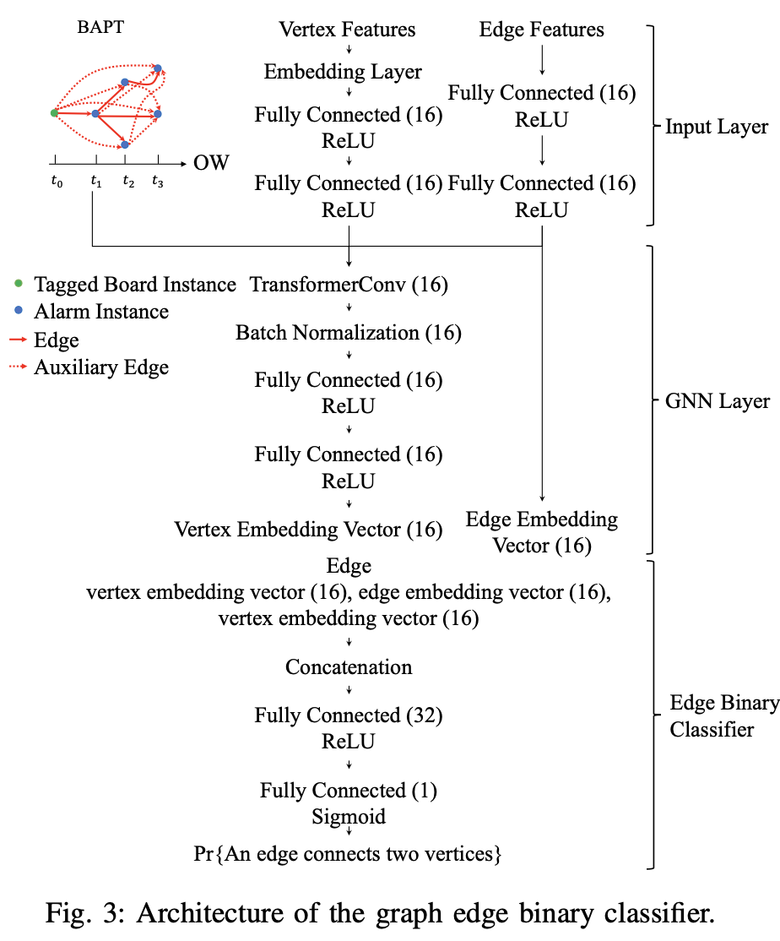
On Board-level Failure Localization in Optical Transport Networks Using Graph Neural Network
Proposed BAPT-FL Framework –
Graph Edge Binary Classifier – to evaluate the edge weights for each potential BAPT.
Input layer - vertex features, edge features, and BAPT.
The vertex features are mapped onto a continuous space via an embedding layer.
Then the vertex and edge features are individually pre-processed with 2 fully connected layers.
A graph edge binary classifier is established to calculate the probability of an edge connecting two vertices as the edge weight.

Slide 11
On Board-level Failure Localization in Optical Transport Networks Using Graph Neural Network
Proposed BAPT-FL Framework –
FG Construction – the process is designed to build a set of FGs, providing the search space for the subsequent BAPT formation.
A device board from network topology is labeled as the tagged board, which is used to generate a subgraph induced by the network topology.
This subgraph contains all boards going through the tagged board’s functional connections i.e., OTS, OMS, and OCH in the setting of OTN.
Then for the alarms reported by the boards in the subgraph, it is examined whether the tagged board could be associated with the subset of these alarms.
If the tagged board and its alarm subset satisfy the corresponding association rule, this subgraph is deemed as a valid FG otherwise it is skipped.
The above procedure will be performed for each device board in the network topology.

Slide 12
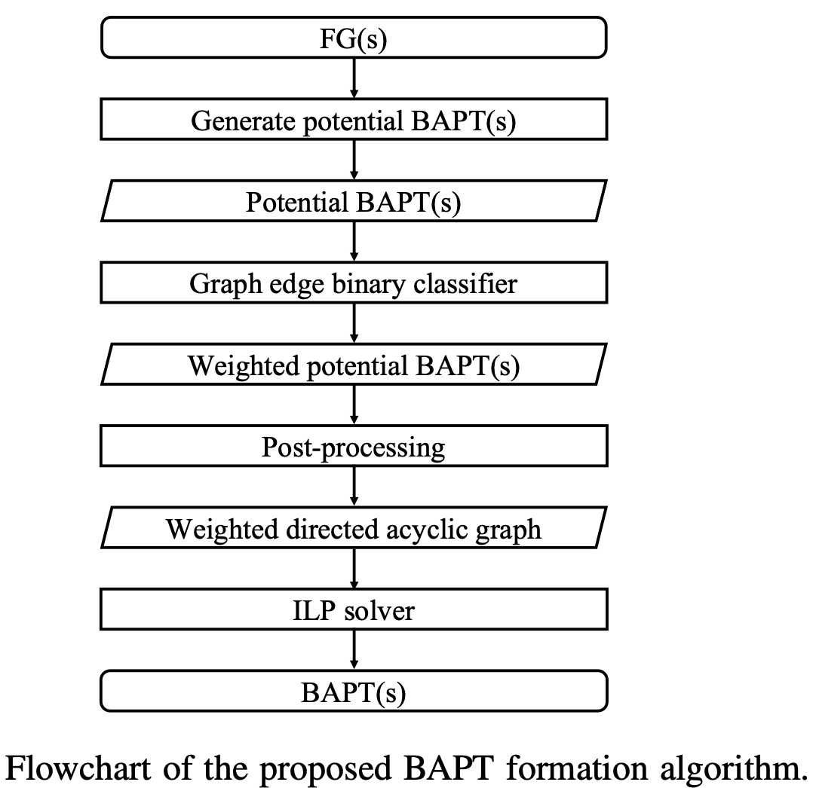
On Board-level Failure Localization in Optical Transport Networks Using Graph Neural Network
Proposed BAPT-FL Framework –
BAPT Formation –
For each FG, a potential BAPT can be generated by pairing its tagged board with each alarm from the alarm subset and connecting all alarm instance pairs with a positive occurrence time gap.
Then each potential BAPT is fed into the trained graph edge binary classifier for weighting its edges.
A weighted directed acyclic graph is prepared as the search space of optimal BAPT (considered as ILP problem).
By solving this ILP, the anticipated BAPT is gained, which achieves both failure localization and alarm correlation.

Slide 13
On Board-level Failure Localization in Optical Transport Networks Using Graph Neural Network
Case studies –
The state-of-the-art counterparts for comparison include BP, LSTM, convolutional neural network (CNN), BERT, GNN, GNN-Dual, and IC-FD.
Setup –
Raw Dataset: The raw dataset is produced from a network with 8 nodes, 264 boards, and 20 lightpaths each going through 14 boards on average and its board-level average degree is 2.2.
Dataset: A dataset of 264 BAPTs is extracted for training the graph edge binary classifier. The dataset is split into training and validation sets with a ratio of 9:1.
Machine Learning Model Counterparts (details in the paper).
Testing Datasets: To assess the benchmark performance for each scheme, a single-board failure dataset of 10 failed boards is randomly selected from the default network state.
ILP Solver and Performance Metrics: a high-performance optimization software (HiGHS) [35] that is dedicated to large-scale sparse linear optimization models is used.

Slide 14
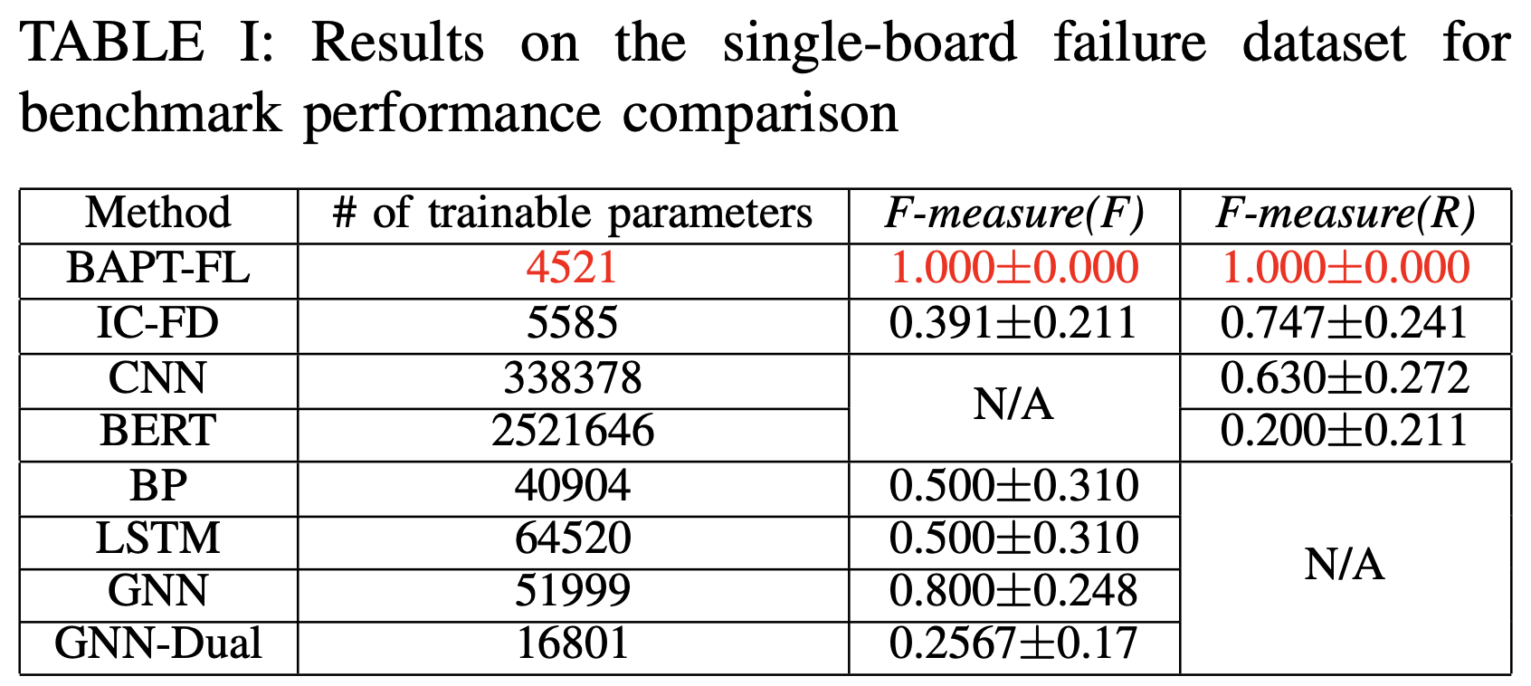
On Board-level Failure Localization in Optical Transport Networks Using Graph Neural Network
Case studies –
Results –

Slide 15
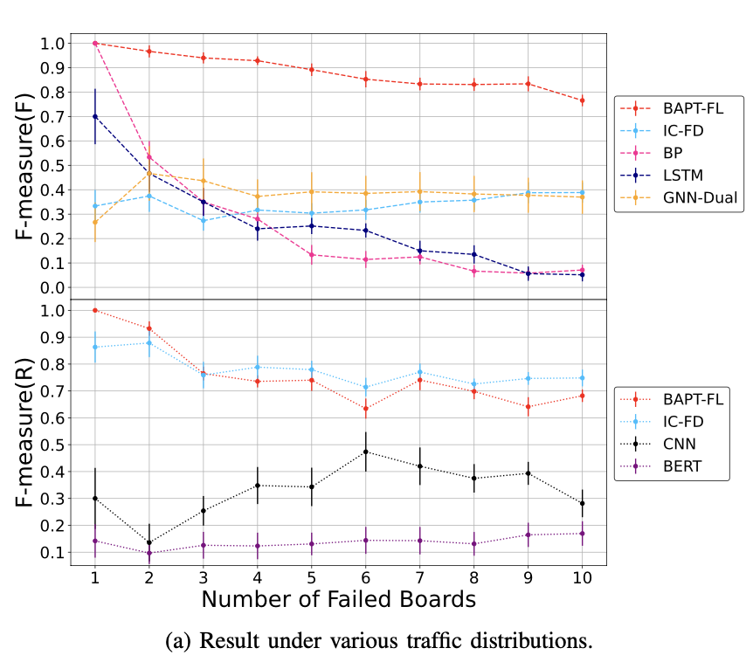
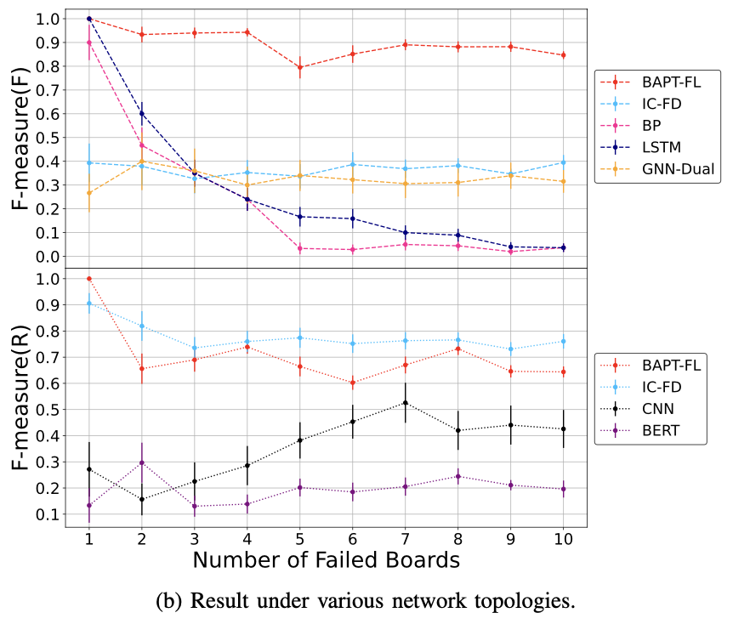
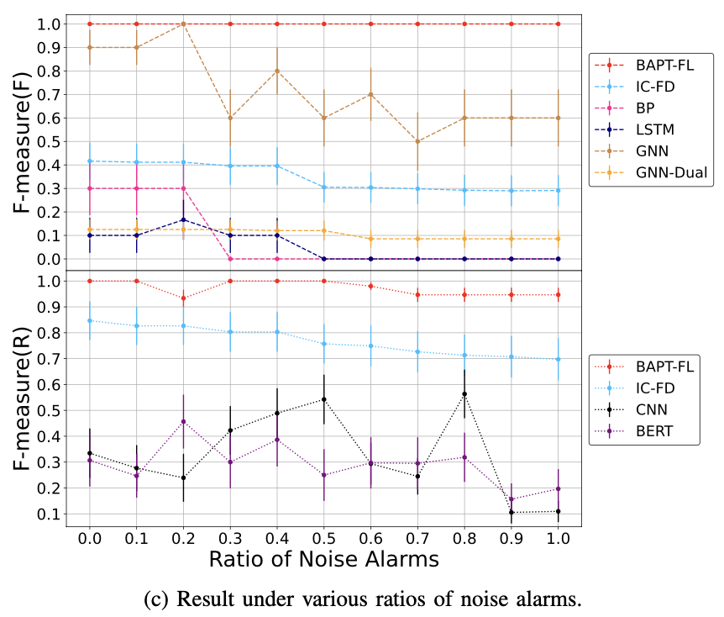
On Board-level Failure Localization in Optical Transport Networks Using Graph Neural Network
Case studies –
Results – two regional failure datasets and a single- board failure dataset with noise alarms.

Slide 16
Energy Consumption Analysis of NIST Selected Post-Quantum Digital Signature Algorithms for Quantum Secure Communications
Comprehensive energy usage assessment in key generation, signing, and verification processes for battery-operated devices’ performance and operational longevity.
It uses NIST-selected algorithms like Sphincs+, Falcon, Crystals-Dilithium, Picnic, Rainbow, and MPPK/DS as a candidate.
It utilizes the M1 chip to establish a benchmark for energy efficiency analysis in post-quantum cryptography.
Picnic’s key generation excellence (0.424 ms, 11.04 W), is closely trailed by MPPK/DS (0.567 ms, 13.12 W). Falcon and Crystals-Dilithium emerge as energy-efficient in signing (2.962 mJ, 4.472 mJ), while Crystals-Dilithium and Rainbow excel in verification (0.647 mJ, 1.143 mJ).

Slide 17
Energy Consumption Analysis of NIST Selected Post-Quantum Digital Signature Algorithms for Quantum Secure Communications
Contributions –
Generation of bash script to log the power consumption of the algorithms in the test.
Energy consumption analysis of all the key-generation algorithms of different digital signatures.
Energy consumption analysis of all the signing algorithms of different digital signatures.
Energy consumption analysis of all the verifying algorithms of different digital signatures.
Consideration of MPPK/DS as one of the additional algorithms in the test and benchmarked with NIST-selected signatures.

Slide 18
Energy Consumption Analysis of NIST Selected Post-Quantum Digital Signature Algorithms for Quantum Secure Communications
Methodology-
post-quantum cryptographic algorithms, such as SPHINCS, Falcon, Crystals-Dilithium, MPPK/DS, Picnic, and Rainbow which are the subset of lattice-based cryptosystems, code-based cryptosystems, and hash-based signatures are considered for evaluating their energy consumptions.
Selection of Algorithms and Platform –
Analyze the above-mentioned post-quantum cryptographic algorithms.
Implementation of MPPK/DS for comparison, implemented in Python and benchmarked with other algorithms.
Perform evaluations on the Apple M1 chip as a representative microprocessor platform.

Slide 19
Energy Consumption Analysis of NIST Selected Post-Quantum Digital Signature Algorithms for Quantum Secure Communications
Methodology -
Data Collection and Implementations –
Download and utilize code files and implementations from the NIST submissions.
Power Consumption Logging –
Prepared a bash script to enable logging of power consumption on the MX power gadget (MX Power Gadget is a software tool specifically designed for monitoring power consumption on Apple’s M1 chip).
Data Analysis –
Correlate power and time data to derive energy consumption in millijoules.
Results Presentation –
Present the analysis findings graphically to facilitate algorithm comparisons.

Slide 20
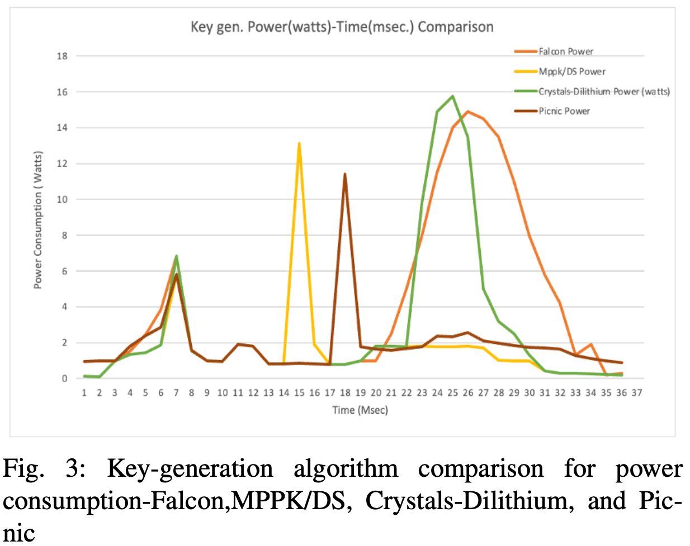
Energy Consumption Analysis of NIST Selected Post-Quantum Digital Signature Algorithms for Quantum Secure Communications
Results –
Key Generation Energy analysis –
FALCON - compact signature sizes, efficient key generation, and fast signing operations. Total Execution time: 11.07 ms and Average power consumed in watts: 12.48 watts
MPPK/DS - provides an additional security level of 384 bits of entropy within a 128-bit field. Total execution time: 0.567 ms and Average power consumption: 13.12 watts
PICNIC - Total execution time: 0.424 ms and Average power consumption: 11.04 watts
CRYSTALS-DILITHIUM - Total execution time: 2.465 ms and Average power consumption: 14.71 watts.

Slide 21
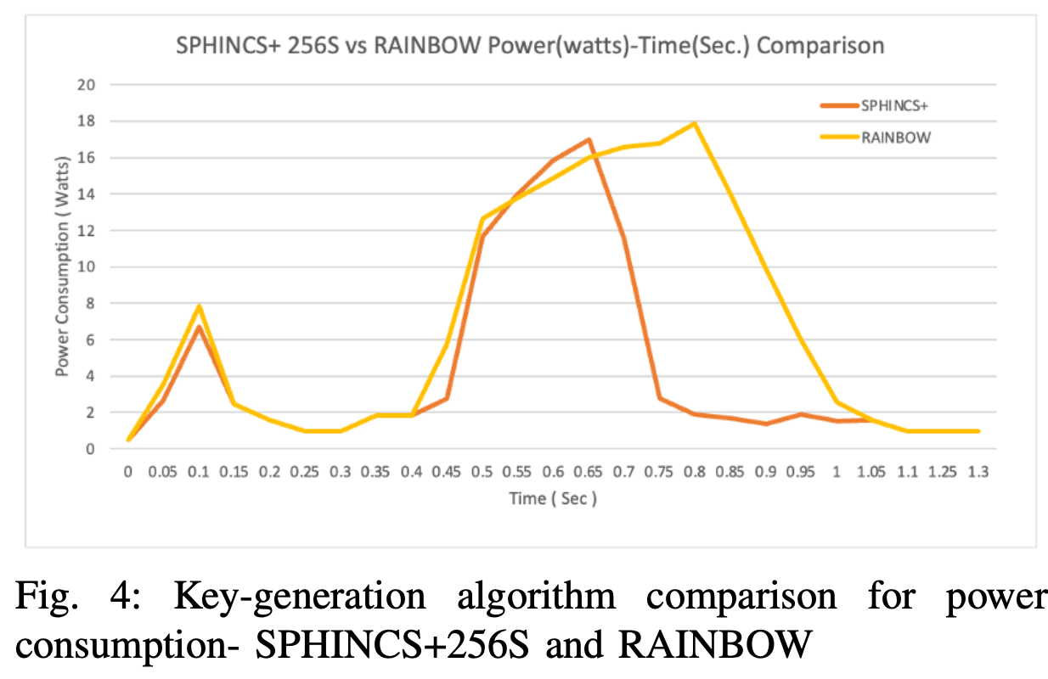
Energy Consumption Analysis of NIST Selected Post-Quantum Digital Signature Algorithms for Quantum Secure Communications
Results –
Key Generation Energy analysis –
RAINBOW - public key size: 161,600 bytes, private key size - 103,648 bytes. Total execution time: 353.45 ms and Average power consumption: 15.30 watts.
SPHINCS+256S - public key size: 64 bytes, private key size: 128 bytes, signature size: 29,792 bytes. Total execution time: 263.34 ms and Average power consumption: 14.06 watts.

Slide 22
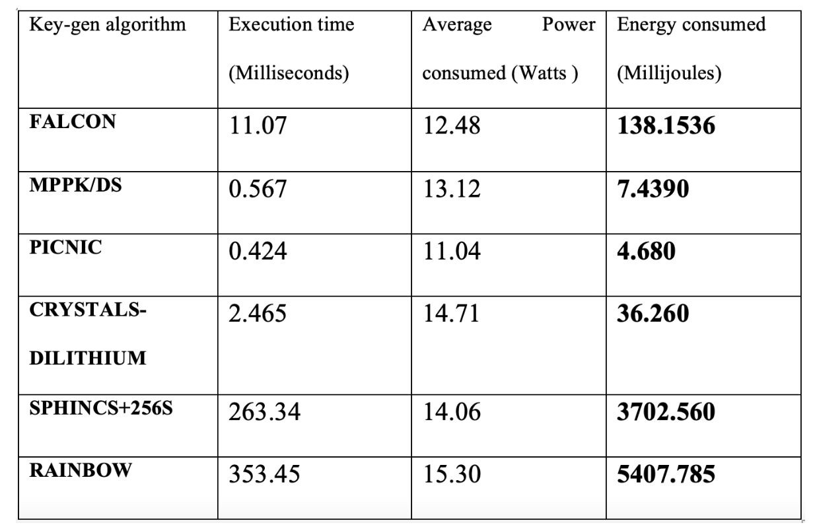
Energy Consumption Analysis of NIST Selected Post-Quantum Digital Signature Algorithms for Quantum Secure Communications
Results –
Energy Consumption for Key-generation Algorithms -

Slide 23
Energy Consumption Analysis of NIST Selected Post-Quantum Digital Signature Algorithms for Quantum Secure Communications
Results –
Signing and Verifying Energy Analysis –
Falcon-512 - Total signing execution time: 0.245 ms, Average signing power consumption: 12.09 watts, Signing Energy Consumption: 0.245 ms * 12.09 watts = 2.962 Millijoules, Total Verifying Execution Time: 0.073 ms, Average verifying Power Consumption: 11.56 watts, Verifying Energy Consumption: 0.073 ×11.56 = 8.438 millijoules.
MPPK/DS - Total signing execution time: 0.312 ms, Average signing power consumption: 15.01 watts, Signing Energy Consumption: 0.312 ms * 15.01 watts = 4.683 Millijoules, Total verifying Execution Time: 0.367 ms, Average verifying Power Consumption: 14.16 watts, Verifying Energy Consumption:0.367 ×14.16 = 5.196 millijoules.
PICNIC - Total signing execution time: 2.3 ms, Average signing power consumption: 12.42 watts, Signing Energy Consumption: 2.3 ms * 12.42 Watts= 28.56 Millijoules, Total verifying Execution Time: 2.548 ms, Average Verifying Power Consumption: 13.51 watts, Verifying Energy Consumption: 2.54 ×13.51 = 34.31 millijoules

Slide 24
Energy Consumption Analysis of NIST Selected Post-Quantum Digital Signature Algorithms for Quantum Secure Communications
Results –
Signing and Verifying Energy Analysis –
Crystals-Dilithium - Total signing execution time: 0.298 ms, Average signing power consumption: 15.01 watts, Signing Energy Consumption: 0.298 ms * 15.01 Watts = 4.472 Millijoules, Total verifying Execution Time: 0.045 ms, Average verifying Power Consumption: 14.26 watts, Verifying Energy Consumption:0.0454 × 14.26 = 0.647 millijoules.
Rainbow - Total signing execution time: 0.298 ms, Average signing power consumption: 17.02 watts, Signing Energy Consumption: 0.298 ms * 17.02 watts = 5.071 Millijoules, Total verifying Execution Time: 0.089 ms, Average verifying Power Consumption: 12.85 watts, Verifying Energy Consumption:0.089 × 12.85 = 1.143 millijoules.
SPHINCS+256S - Total signing execution time: 1056 ms, Average signing power consumption: 14.51 watts, Signing Energy Consumption: 1056 ms * 14.51 watts = 15322.56 Millijoules, Total verifying Execution Time: 2.067 ms, Average verifying Power Consumption: 13.87 watts, verifying Energy Consumption: 2.067 × 13.87 = 28.66 millijoules

Slide 25
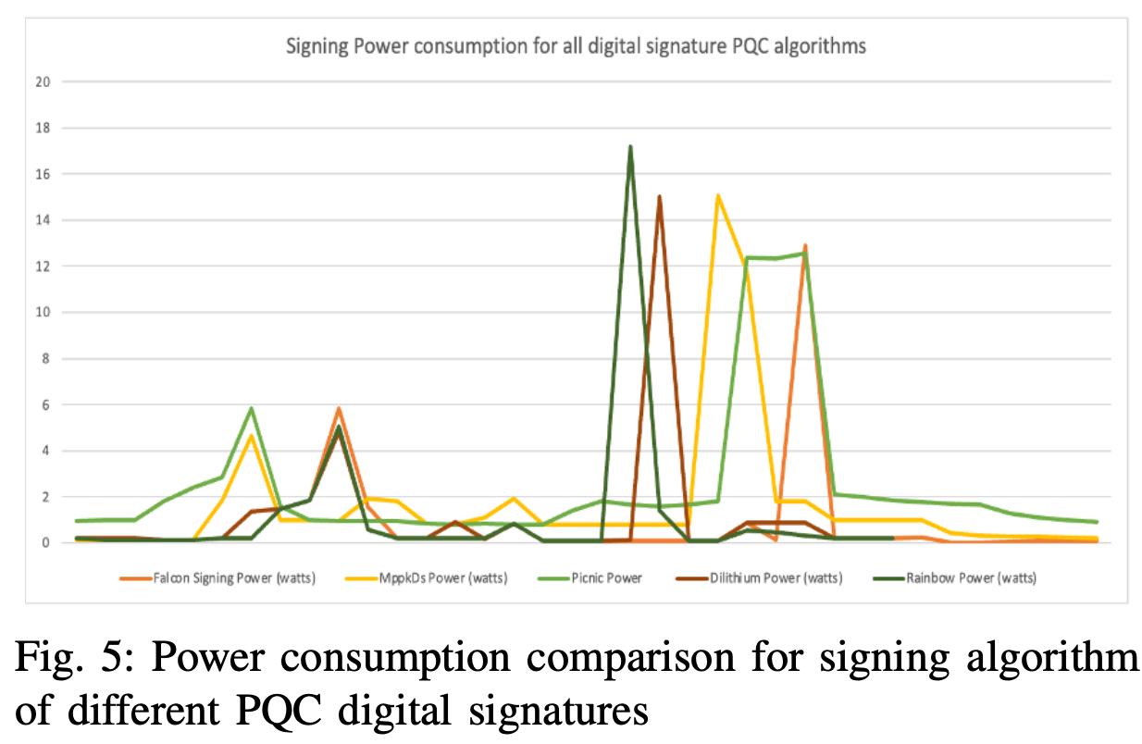
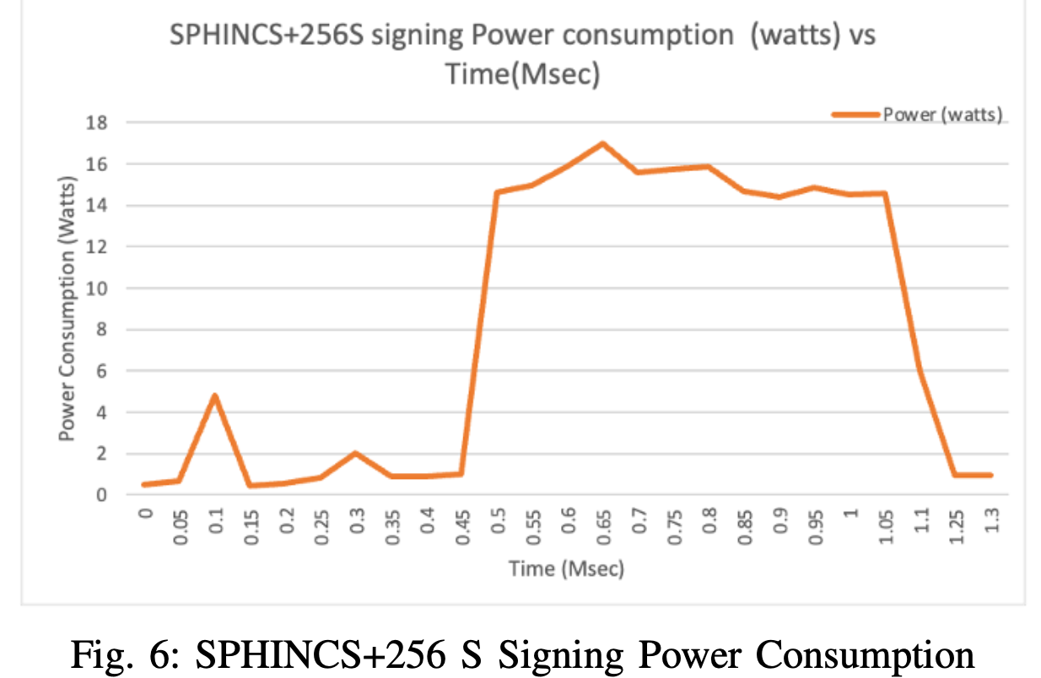
Energy Consumption Analysis of NIST Selected Post-Quantum Digital Signature Algorithms for Quantum Secure Communications
Results –
Signing and Verifying Energy Analysis –

Slide 26
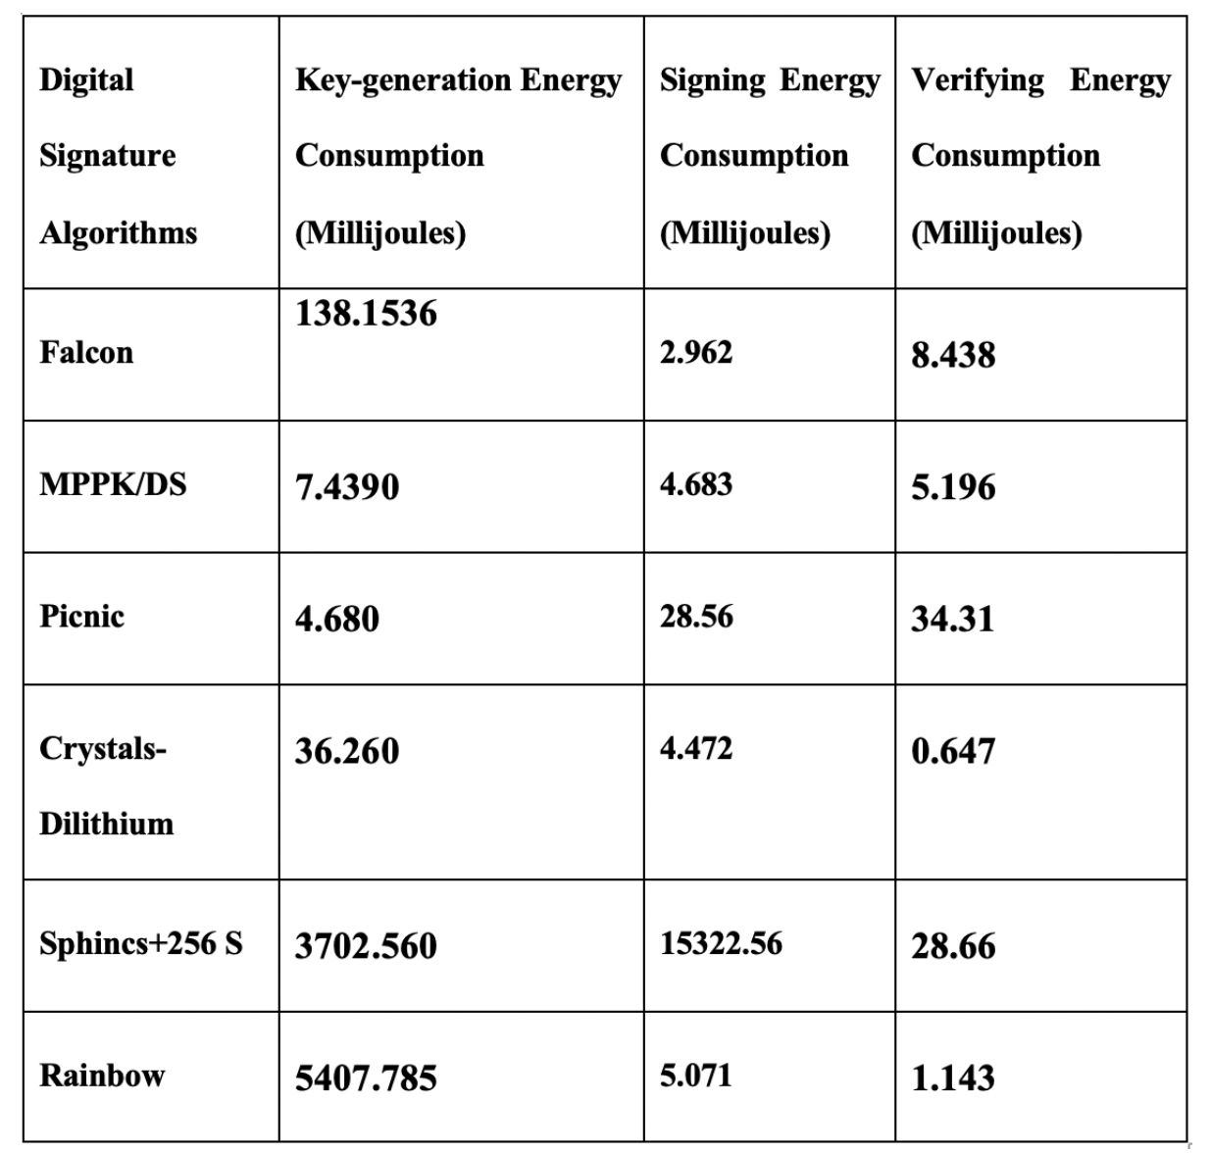
Energy Consumption Analysis of NIST Selected Post-Quantum Digital Signature Algorithms for Quantum Secure Communications
Results –
Energy Consumption for Key-generation Algorithm of different PQC Digital Signature Schemes –

